Slide 1
Support Vector Machines – Part 2
UIUC ECON 490: Applied Machine Learning in Economics

Slide 2
What Makes it a Machine?
Decision boundaries take many functional forms
“kernels”
Support vector classifier vs SVM?
What kernel does a SVC use?

Slide 3
SVM Applications
Regression
Classification (binary and multiclass)
Anomaly detection (not covered in this course ☹)
“Is this observation like the others?”
Ex) Credit card fraud

Slide 4
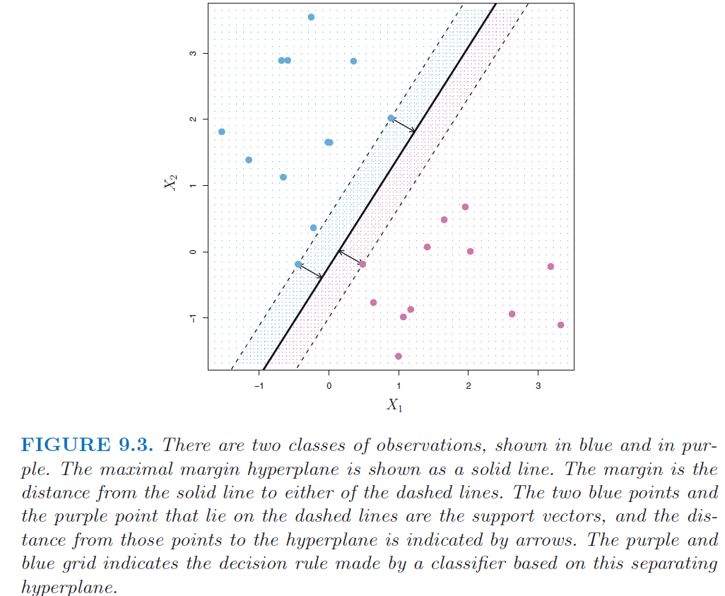
Decision Boundary Refresher

Slide 5
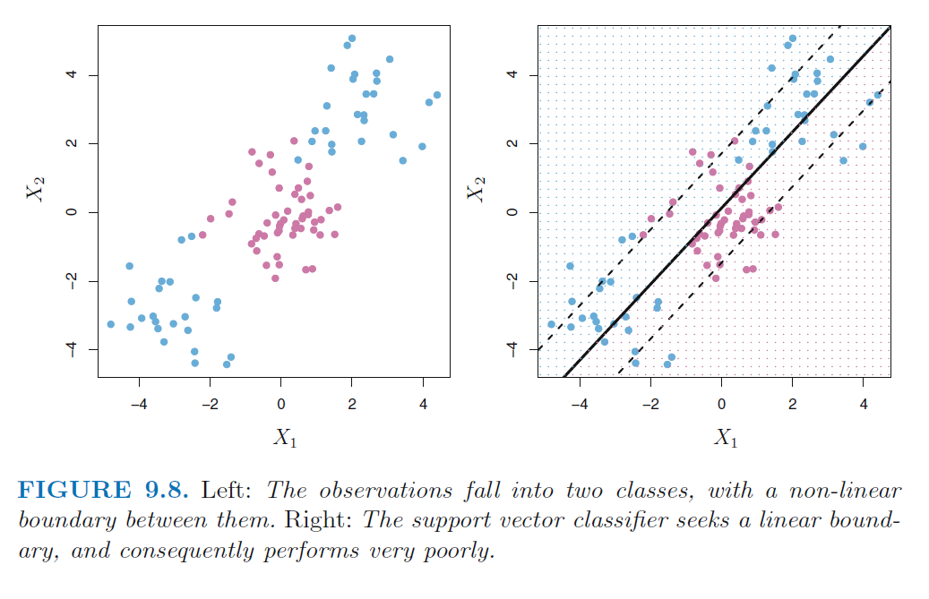
Non-linear Boundaries

Slide 6
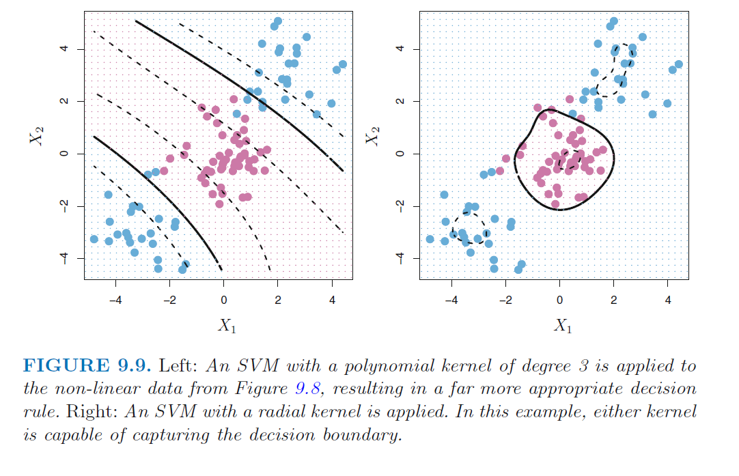
Non-linear Boundaries: Polynomial & Radial

Slide 7
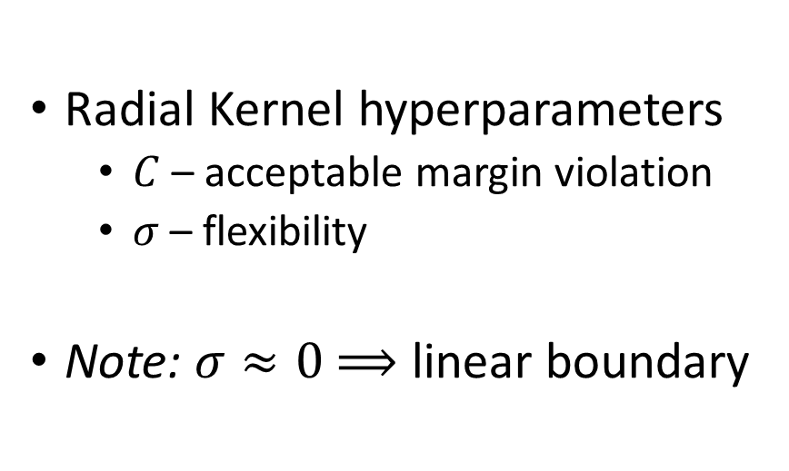
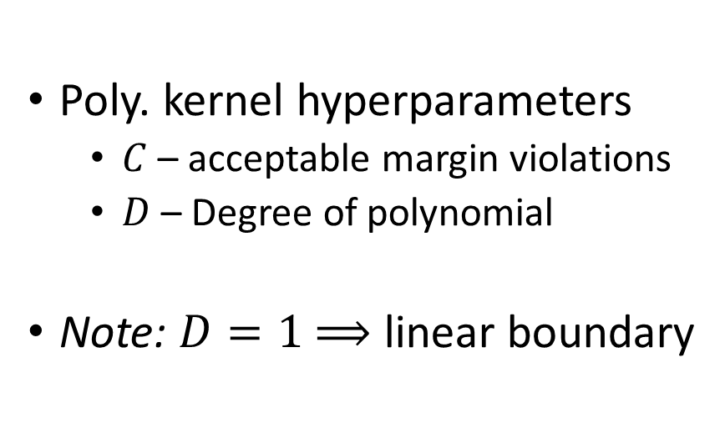
Kernels
Poly. kernel hyperparameters
$C$ – acceptable margin violations
$D$ – Degree of polynomial
Note: $D=1$ $⟹$ linear boundary
Radial Kernel hyperparameters
$C$ – acceptable margin violation
$σ$ – flexibility
Note: $σ≈0$ $⟹$ linear boundary
Other kernels exist!

Slide 8
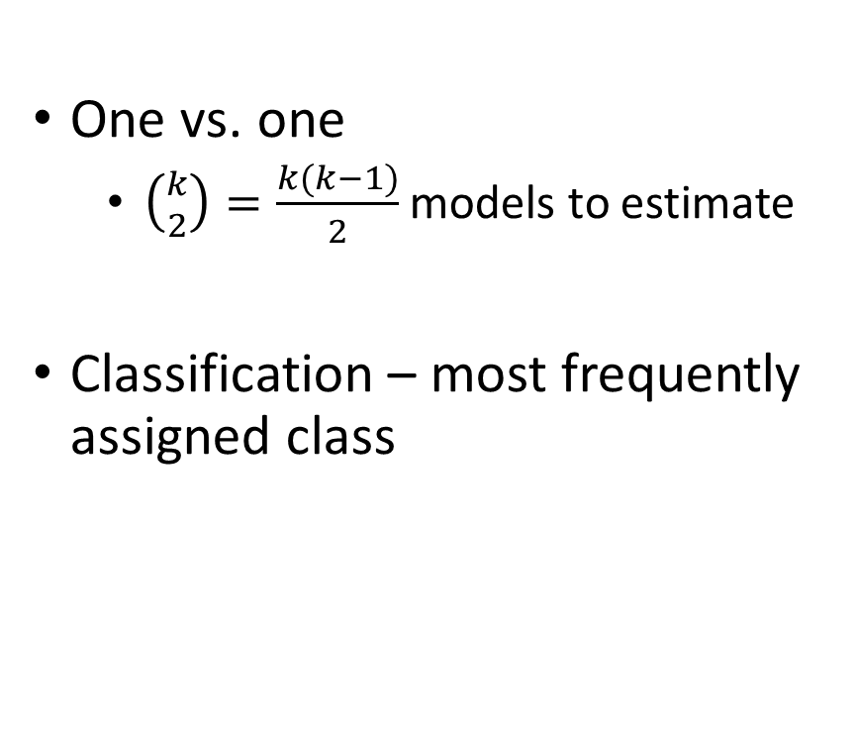
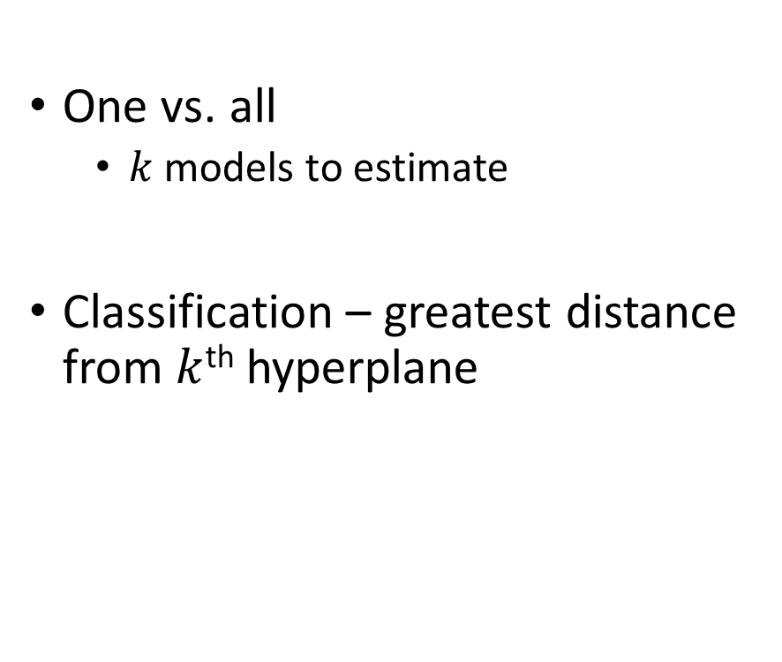
Multiple Classes ($k$)
One vs. one
$\left({k \atop 2}\right)$ $=\frac{k(k−1)}{2}$ models to estimate
Classification – most frequently assigned class
One vs. all
$k$ models to estimate
Classification – greatest distance from $k$^{th} hyperplane

Slide 9
SVM Regression
Classification – fit the widest street between the data
Regression – opposite idea:
fit the widest street along the data
All kernels apply!

Slide 10
To Do
Watch
3blue1brown first three neural network videos
Complete
Lab 9.6

